Slide 1
What are the most common job level among the Respondents?
Since this is a categorical data, I didn’t include the measures of center in this analysis.
Most of the respondents are individual contributors at their places of employment.
The next highest occurring group is the Manager, followed by those who declared their job level is not applicable to them. These are probably those who are not employed but we don’t have enough data to substantiate this fact.

Slide 2
Where Do The Respondents Come From?
This is a categorical data. So, I have left out the measures of centers.
Among the respondents, the country with the most representation is Argentina with 73 people while the country with the least representation is Canada.
It can also be seen that some of these countries tie with regards to their representation among the respondents.

Slide 3
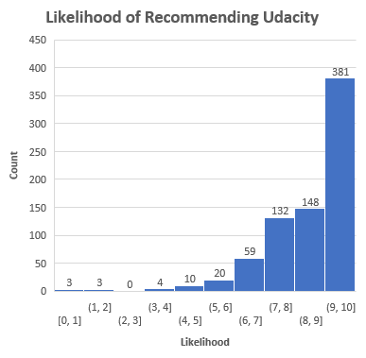
What’s the distribution of the likelihood of recommending Udacity?
Statistic | Value
Mean | 8.98
Median | 10.00
Mode | 10.00
Standard Deviation | 1.36
Most of the respondent rated the likelihood of recommending Udacity as 10. Mean=8.98. Therefore, an average respondent gave a likelihood of 8.98 out of 10. The Median is 10. This means the middle recommendation value is 10 (if ordered from the smallest to the highest.) Standard deviation of 1.36 indicate a small variation (spread) in the distribution of recommendation by the respondents.
The minimum and the maximum recommendations are 0 and 10 respectively. Thus, the range is 10. This shows more spread from the mean but it could be due to some outliers.
The distribution is negatively skewed. Hence, the mean is less than the median and the mode.
It is interesting that 2 respondents have zero likelihood of recommending Udacity. Not sure why. However, this is not significant of the population.

Slide 4
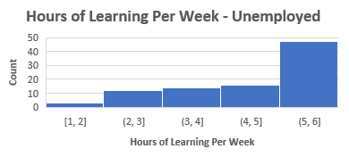
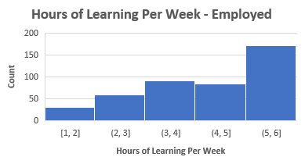
How does the hours of learning per week vary with employment status?
For the employment record among all the respondents, the mean is 4.75. Therefore, an average respondent spent an average of 4.75 hours learning per week. The median is 5. Therefore, half of the respondents spent 5 hours leaning per week and half spend less than 5 hours learning per week. The mode is 6, meaning most of the respondents spent 6 hours learning per week. Standard deviation of 1.31 implied there is a small spread in the distribution of hours spent per week among the respondents. The range is 5. This shows more spread than the deviation. It is possible the skewness made the difference.
There are significantly more employed people among Udacity graduates than unemployed people.
For both unemployed and employed groups, the highest occurring hours of learning per week is the bin 5-6 hours. Both distributions are negatively skewed. Hence, mean is less than median.
Employment Status | Total
Unemployed | 92
Employed | 432
Total | 524
Statistic | Value
Mean | 4.75
Median | 5.00
Mode | 6.00
Standard Deviation | 1.31

